Slide 1
Running Back Performance Prediction
Dylan Ott • Kranthi Pedamajji • Ganga Surendra Basva

Slide 2
1
INTRODUCTION
What’s the purpose of this model, and why does it matter?

Slide 3
Introduction
Objective: Predicting Running Back Performance
Today’s NFL is highly data-driven, and that extends beyond just training, coaching, and staffing decisions.
Media personalities are using data to make rankings
AWS is using AI to predict things like potential defensive schemes in real time.
As sports betting becomes more popular, companies like BetMGM, Fanduel, and Draftkings are using player data to set betting lines that are fair while still making revenue for the casino.
Our goal was to predict a single stat from a single position on the football field: running back rushing yards.
This stat is one of many that impact the outcome of a game, but it makes a great target as it involves every position on the offensive side of the team.
Additionally, it holds added weight for things like fantasy and sports betting, as well as being a key factor in end-of-season awards.
How Are We Achieving This?
By analyzing historical performance data (e.g., previous rushing totals, games started).
By incorporating demographic information (e.g., age, years of service, team) to understand patterns and trends.

Slide 4
Key Questions
When our model is complete, we hope to answer questions like…
Does a player’s age have a significant impact on their performance?
Do certain teams or coaches have a higher likelihood of gaining more rushing yards in a season?
Is the player themself the most important variable in this model?
Which model gives us the best result for learning all of this?

Slide 5
2
DATA EXPLORATION
“What’s the scouting report on this guy?”

Slide 6
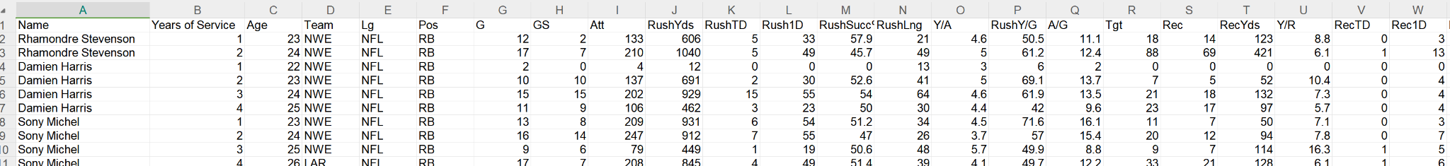
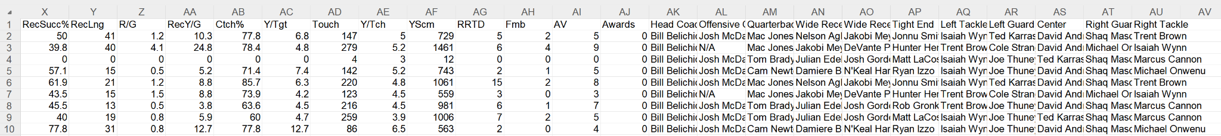
Data Collection & Preprocessing
Datasets and collection:
Data Collection: Created two html scrapers to get the data from “https://www.pro-football-reference.com”.
Data.xlsx: Contains 785 rows and 47 columns, detailing NFL players' historical performance metrics and team composition from 2013 to 2022.
TestData.xlsx: Includes 69 rows and 47 columns, focusing on testing specific player attributes and performance metrics in 2023.
Key Attributes:
Player Information: Name, Age, Position, Team.
Performance Metrics: Games Played (G), Rushing Attempts (Att), Rushing Yards (RushYds), Yards per Game, etc.
Team Details: Offensive Coordinator, Quarterback etc,.

Slide 7
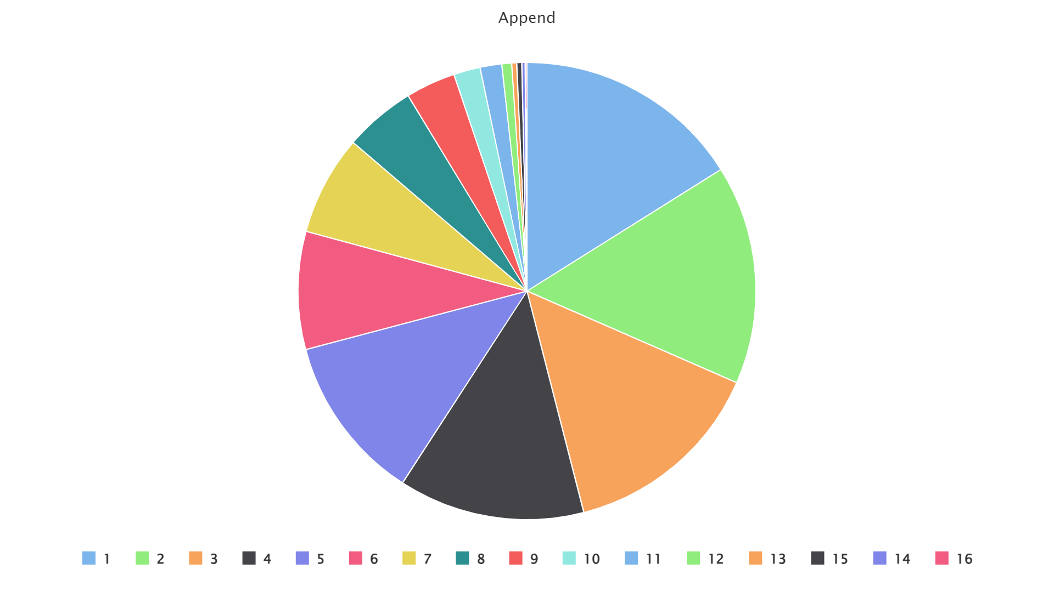
Data Quality Assurance
To ensure our dataset was suited for training our models, we needed to make sure that it contained a healthy variety of data in all aspects. Here, we see the distribution of our entries by Years of Service (how long a player has been in the NFL, starting at 1 for a rookie). It seems like our data has a good spread!

Slide 8
3
ANALYSIS
“Analytics are ruining football.” - Someone’s Grandfather, probably

Slide 9
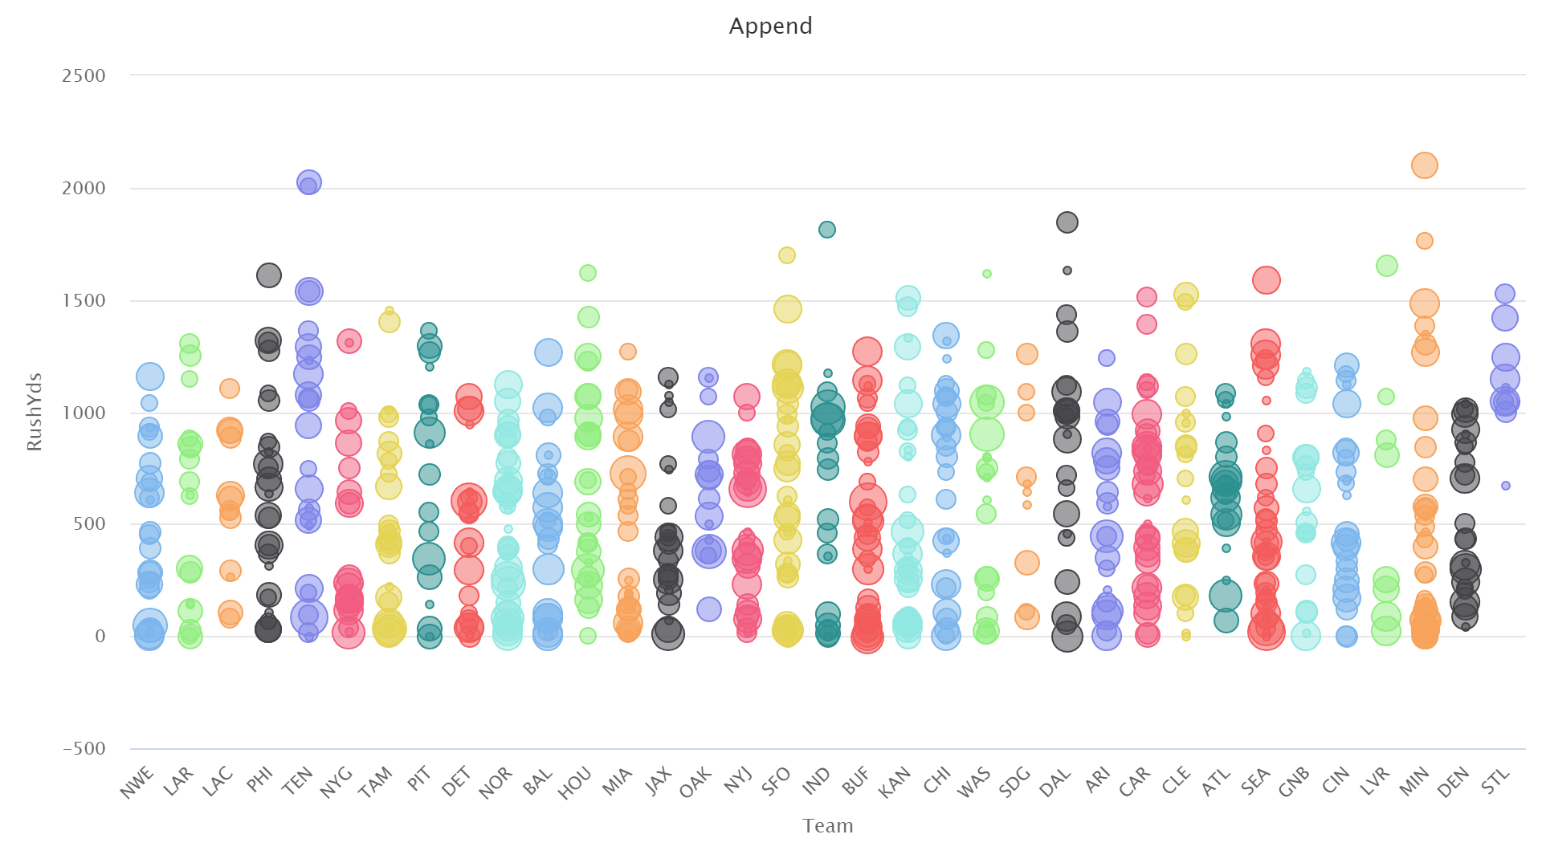
First Impressions - Team
First of all, we wanted to see if there were any immediate correlations we could draw that would inform our expectations. For example, does the team you play for or how long you’ve been in the NFL have a discernible impact on your overall rushing yards? Based on this chart, it does not seem so.
X-axis (and color) : Team
Y-axis : Rushing Yards
Size of bubble : Years of Service

Slide 10
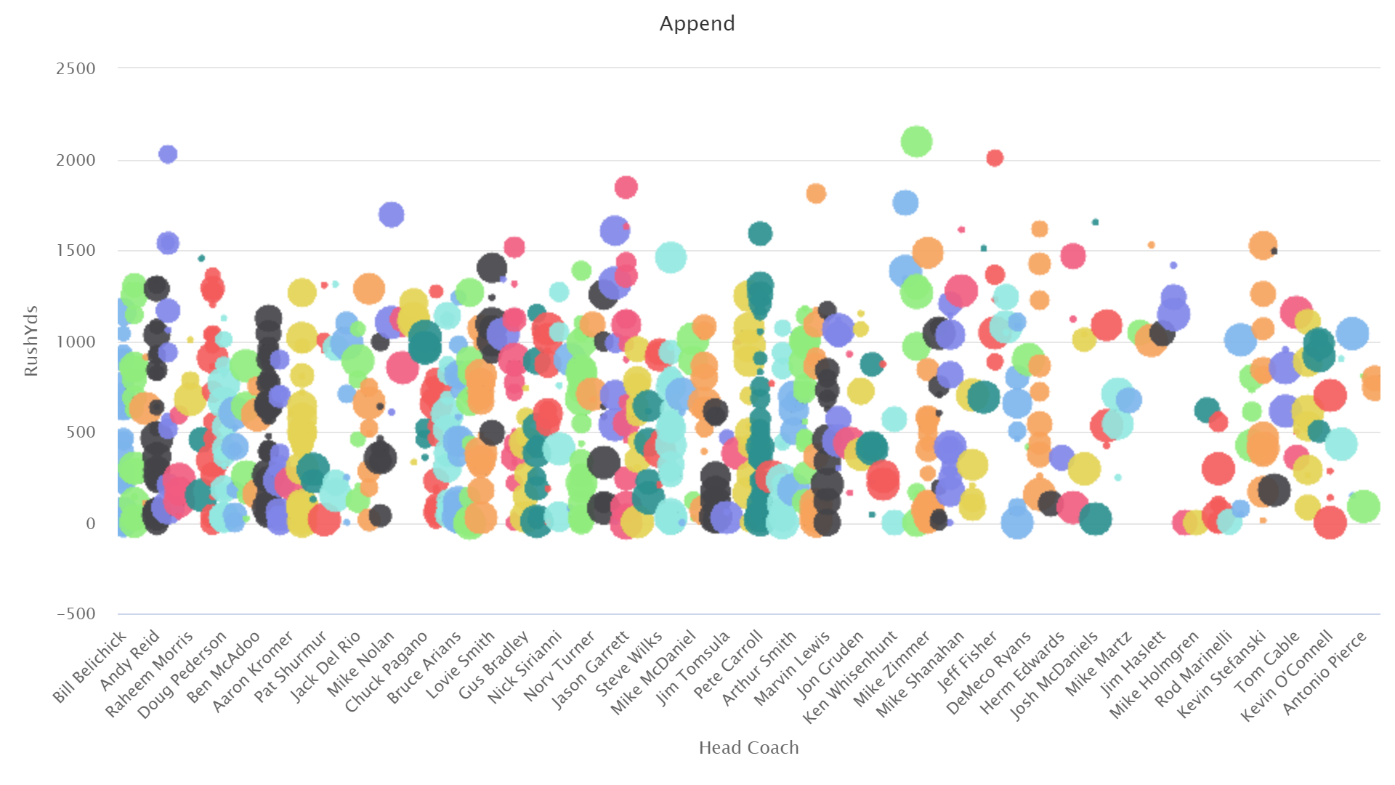
First Impressions - Coach
Similar to the previous chart, this plot looks at whether or not the RB’s head coach has an obvious impact on their overall performance. Once again, based on the spread we see here, it doesn’t seem like those two things are strongly correlated enough for a human to discern.
X-axis (and color) : HC
Y-axis : Rushing Yards
Size of bubble : Years of Service

Slide 11
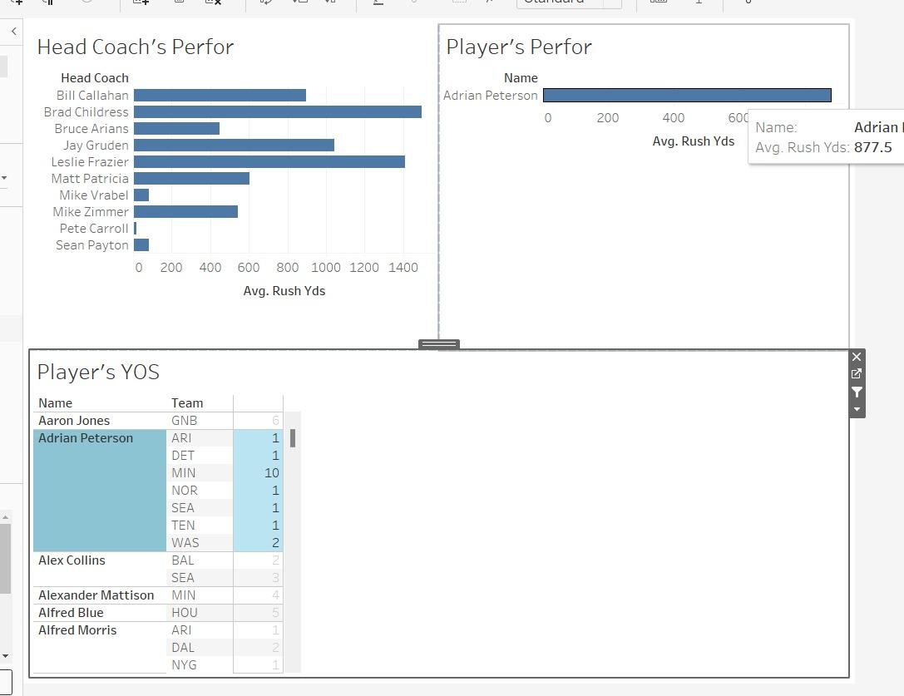
Analysis
By using the Tableau tool, we created a dashboard to understand a metrics and relationship between them.
Head Coach's Performance:This section analyzes head coaches' impact on their team's average rushing yards.
Player's Performance: Highlights Adrian Peterson's average rushing yards, providing a snapshot of his performance.
Player's Years of Service: Provides an overview of players' career longevity and team affiliations.
By using this interactive analysis in tableau dashboard , we can know which covered most average no of yards under which head coach and who is best coach/player among everyone.

Slide 12
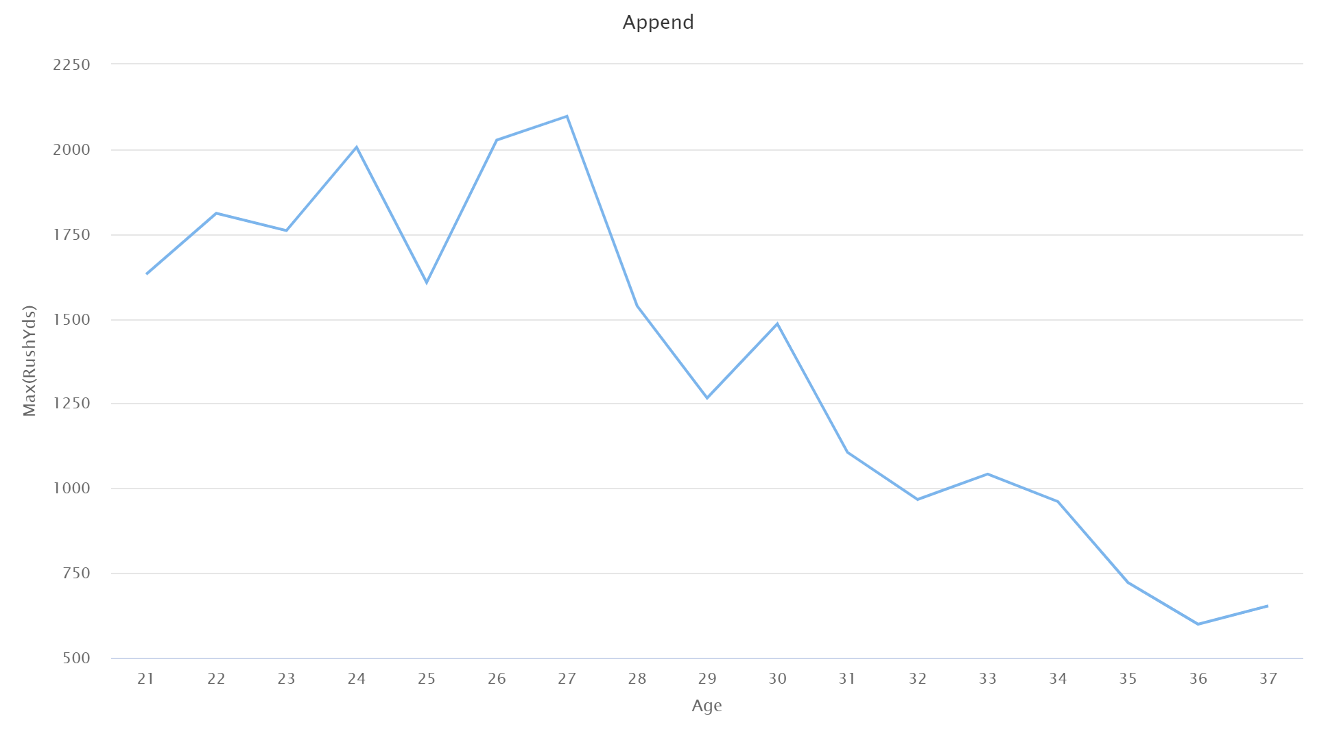
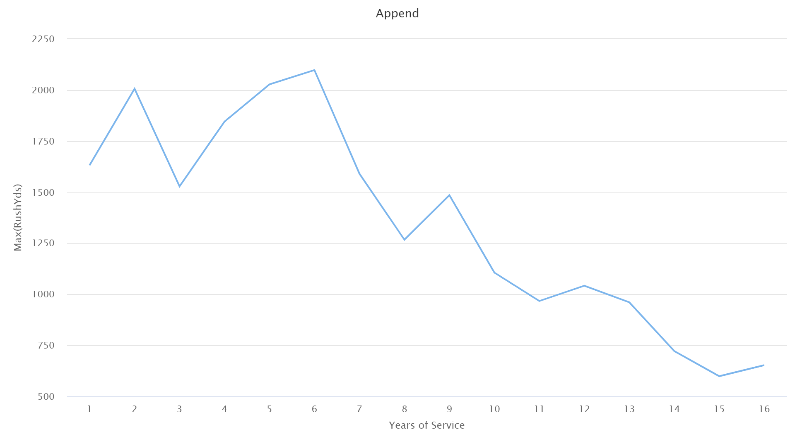
First Impressions - Age and YoS
Our exploration did reveal a couple of variables that may be useful for understanding how the model will predict - age and years of service. As shown by the charts below a player, a player’s performance can be expected to diminish as their age (left) and YoS (right) increase.
This is perfectly logical, as younger players that lack the injury history of veterans would be expected to have an advantage over older players in the league. Additionally, if a player doesn’t perform well early in their career, it’s unlikely that they’ll be signed to another team to continue playing at all.

Slide 13
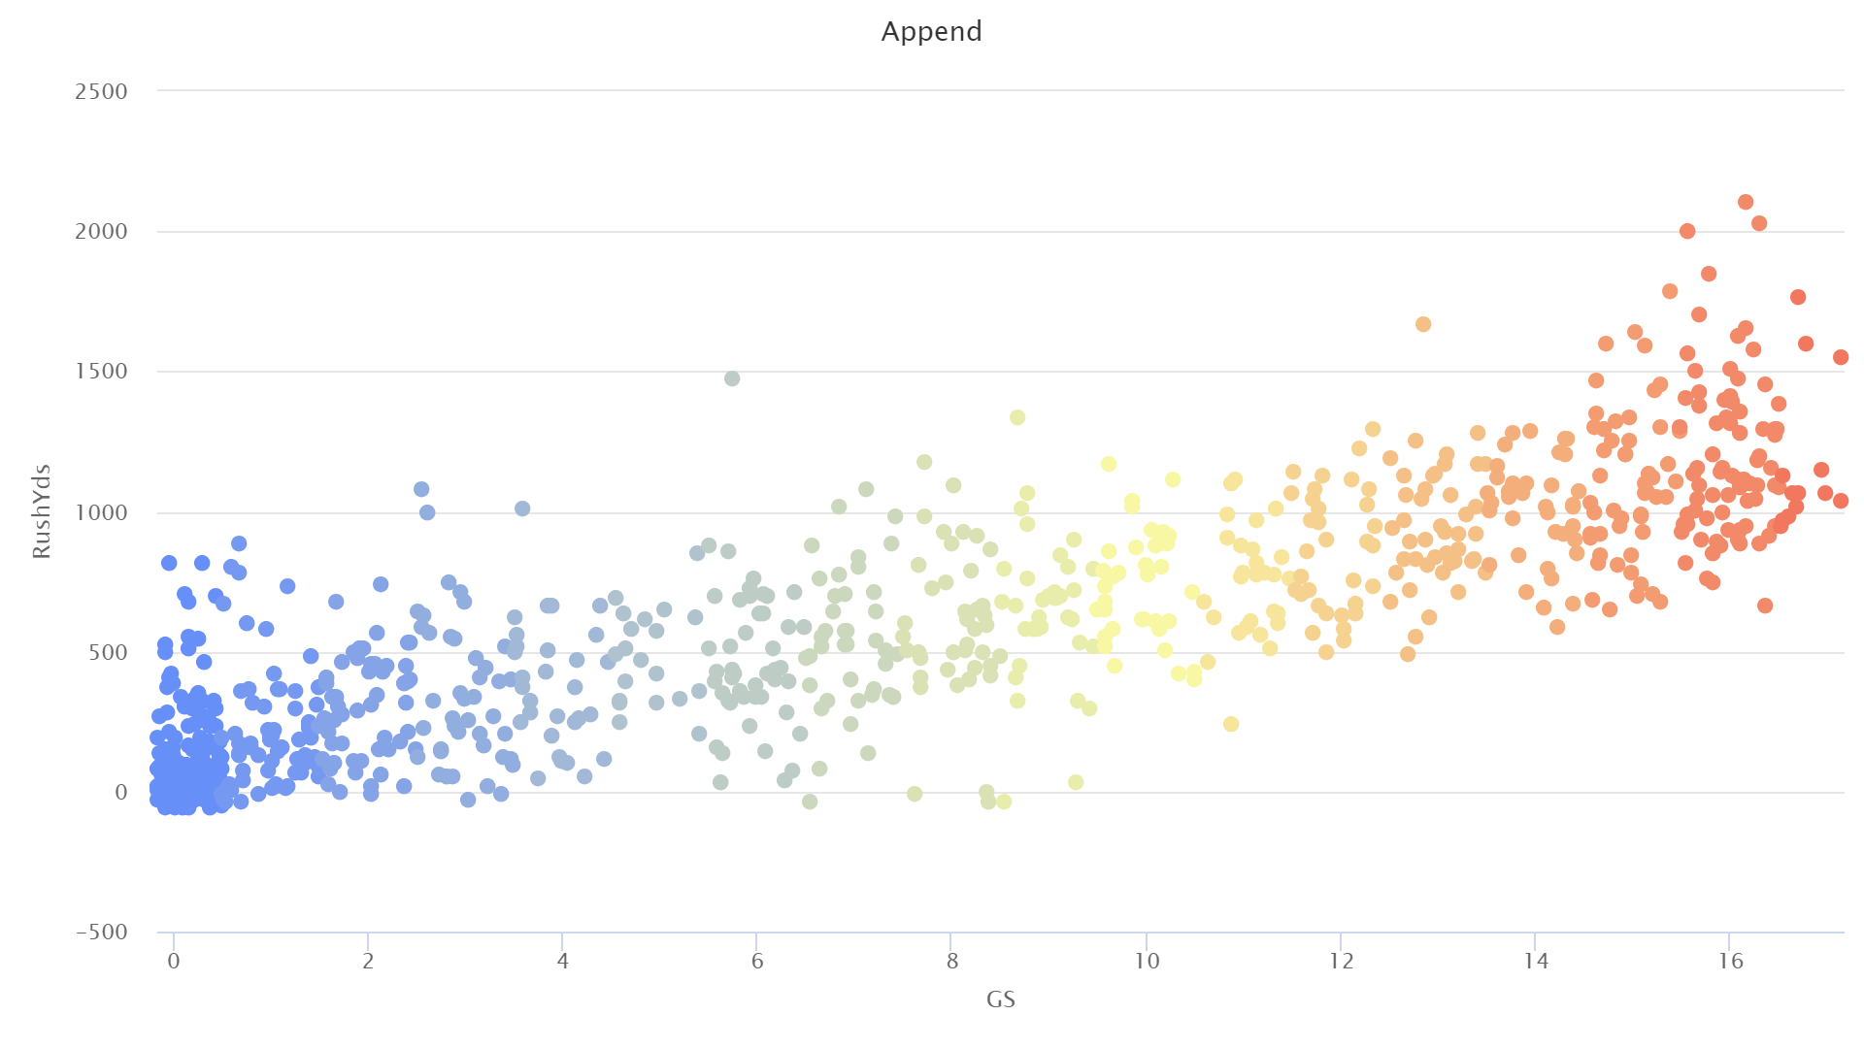
First Impressions - Games Started
The final (and most obvious) variable that revealed a logical trend was the number of games started by a player. Naturally, if a player is playing in more games as the starter, they will see more opportunities to increase their yardage. This isn’t a hard and fast rule, as shown by some of the low values on the chart to the left, but it’s a very clear trend.

Slide 14
A Note about Outliers
As seen in the previous charts, there are outliers with respect to the rushing yards field in the dataset.
In most cases, these would be pruned because of their negative impact on the data.
However, we have decided to leave them in our dataset.
These performances generally come from the same handful of players (Adrian Peterson, Derrick Henry), which could be critical information as the model learns how much to weight a player’s name in its predictions.
As such, they don’t necessarily appear as outliers for that player, but rather the maximum in a subset of data where all values for rushing yards are generally higher than the dataset.
Additionally, as our goal is to predict player performance, it benefits our model to have the opportunity to learn about what goes into a high-value season (Is it always the same team? The same player? The same Quarterback or Center?)
Finally, the removal of outliers was tested, and had little impact on the overall performance of the model.

Slide 15
4
4
METHODOLOGY
“There is no substitute for work” - Vince Lombardi

Slide 16
Methodology
We approached this problem unsure of which model would give us the best results, so we tried a few:
Random Forest
Advantages:
Reduces overfitting compared to individual decision trees.
Handles large datasets and complex relationships effectively.
Provides feature importance scores to identify key predictors.
Deep Learning
Advantages:
Handles non-linear relationships and intricate feature interactions that simpler models may miss. Suitable for datasets with high dimensionality.
Scalability:Performs well with large datasets, where traditional models may struggle.
Neural Net
Advantages:
Simple implementation.
Able to detect complex nonlinear relationships that are imperceptible to humans.
Fantastic for analyzing historical data.
Linear Regression
Advantages:
Able to clearly show the relationship between variables.
Well-suited to our goal of predicting a numerical value.
Simple implementation.

Slide 17
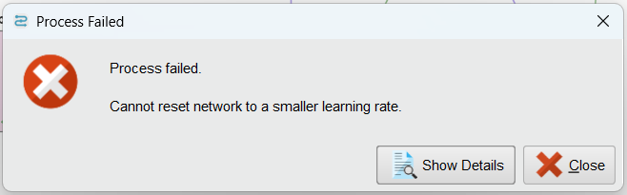
False Start!
Despite our best efforts, both the neural net and linear regression models were unable to be tested.
This was due to a rare but known issue in RapidMiner that can occur when working with large datasets that have null or missing values.
Our dataset did not have any missing values, and even when using nodes to replace missing values, the error still persisted.
Thus, we were forced to move on to our two other methods of Random Forest and Deep Learning.

Slide 18
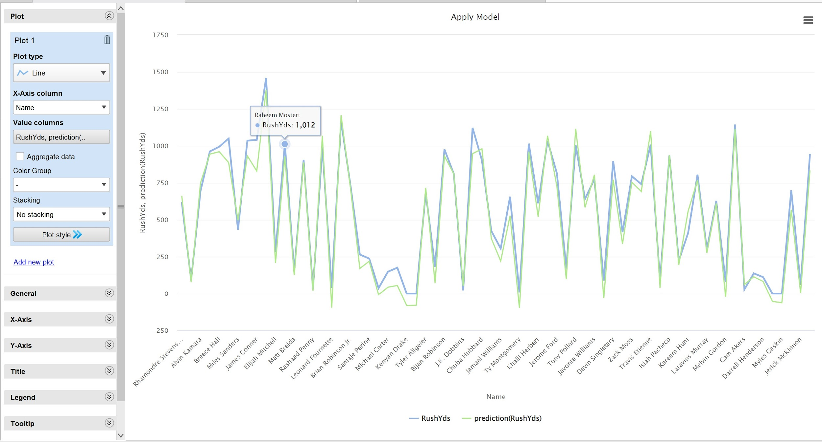
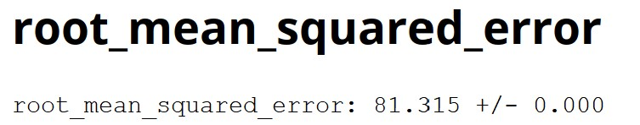
Early Stages
Before we dive too deep into the modelling process, we wanted to know if it was at all possible to get a model to make an accurate prediction with the data we collected.
To test this, we set up a small Deep Learner with a few inputs that we considered easy to use for prediction:
Name, Age, Years of Service, Games played, Touches, Rushing TD’s, Rushing 1D’s, RushYds
The data set was split into training and test by year - 2023 data was our test set, and anything prior went into the training set.
The model was very successful, which was a sign that a very accurate model was possible.
However, some of these inputs (TD’s, 1D’s, Touches) aren’t exactly real-world appropriate - these are unknown at the start of the season, and therefore couldn’t be used as inputs to the model in a real-world scenario.
Knowing this, we decided that the inputs given to the models would be:
Player demographic info (Name, Age, Years of Service)
Team demographic info (Head Coach, Offensive Coordinator, Quarterback, Wide Receiver 1 and 2, Left Tackle, Left Guard, Center, Right Guard, and Right Tackle)
RushYds (the label)

Slide 19
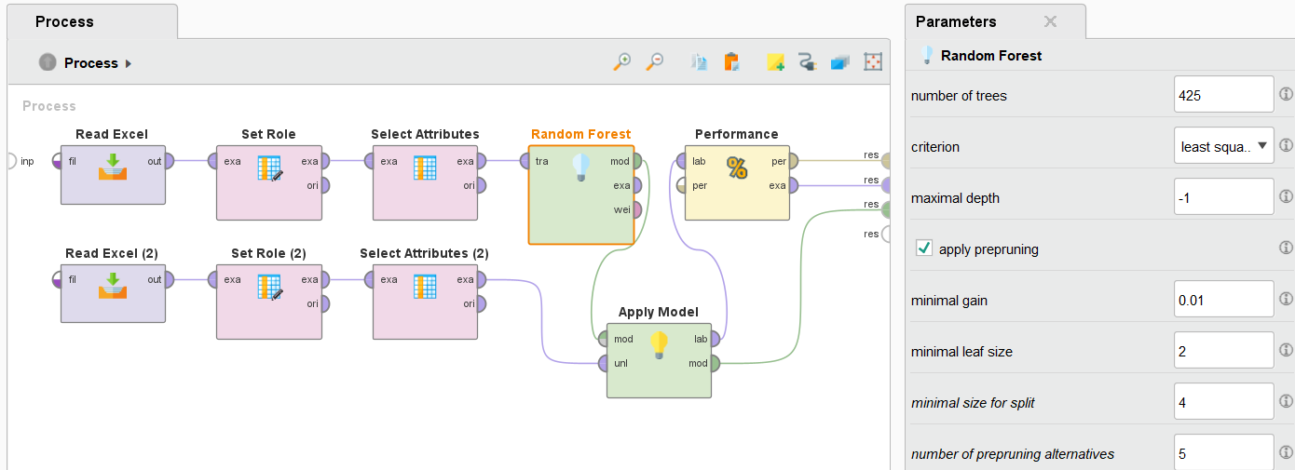
Design - Random Forest
A Random Forest model was used with the parameters shown to achieve the forthcoming results.
The number of trees was set to 425. This number was discovered through manual binary search.
The maximal depth is set to -1 to allow the trees to be as deep as needed, as long as they meet the criterion.

Slide 20
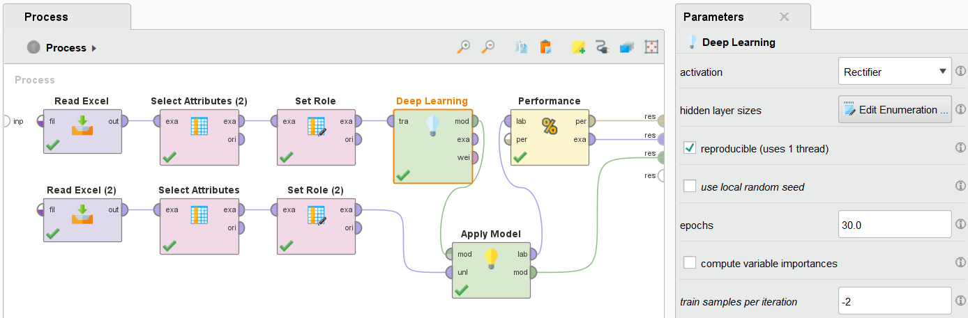
Design - Deep Learning
A Deep Learning model was used with the parameters shown to achieve the forthcoming results.
A learner with 9 layers of 100 nodes was used. Once again, this number was achieved through manual experimentation.
The model was set to train over 30 epochs, although it would stop early after 28 due not meeting the learning threshold.

Slide 21
RESULTS
“The kick is up, it’s got the distance, it… is…”

Slide 22
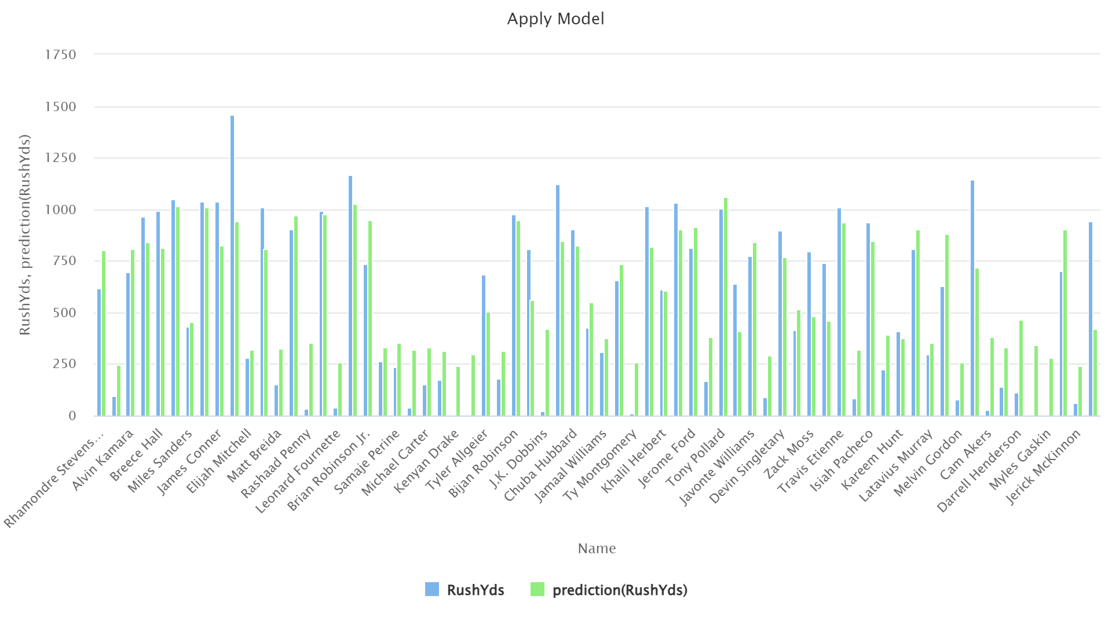
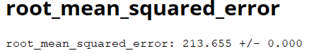
Results - Random Forest
The model performed moderately well, but there are some interesting insights to note about its predictions.
It rarely predicted that a player would have less than 250 rushing yards.
It was also rare that it would predict a player to have more than 1000 rushing yards, something that is achieved regularly in the NFL.
While it’s obvious that it had learned from the data, it seems that things like teammate and coach data may not have had a high enough weight, which is made evident by players that had standout years (Christian McCaffrey) being grossly under-predicted.

Slide 23
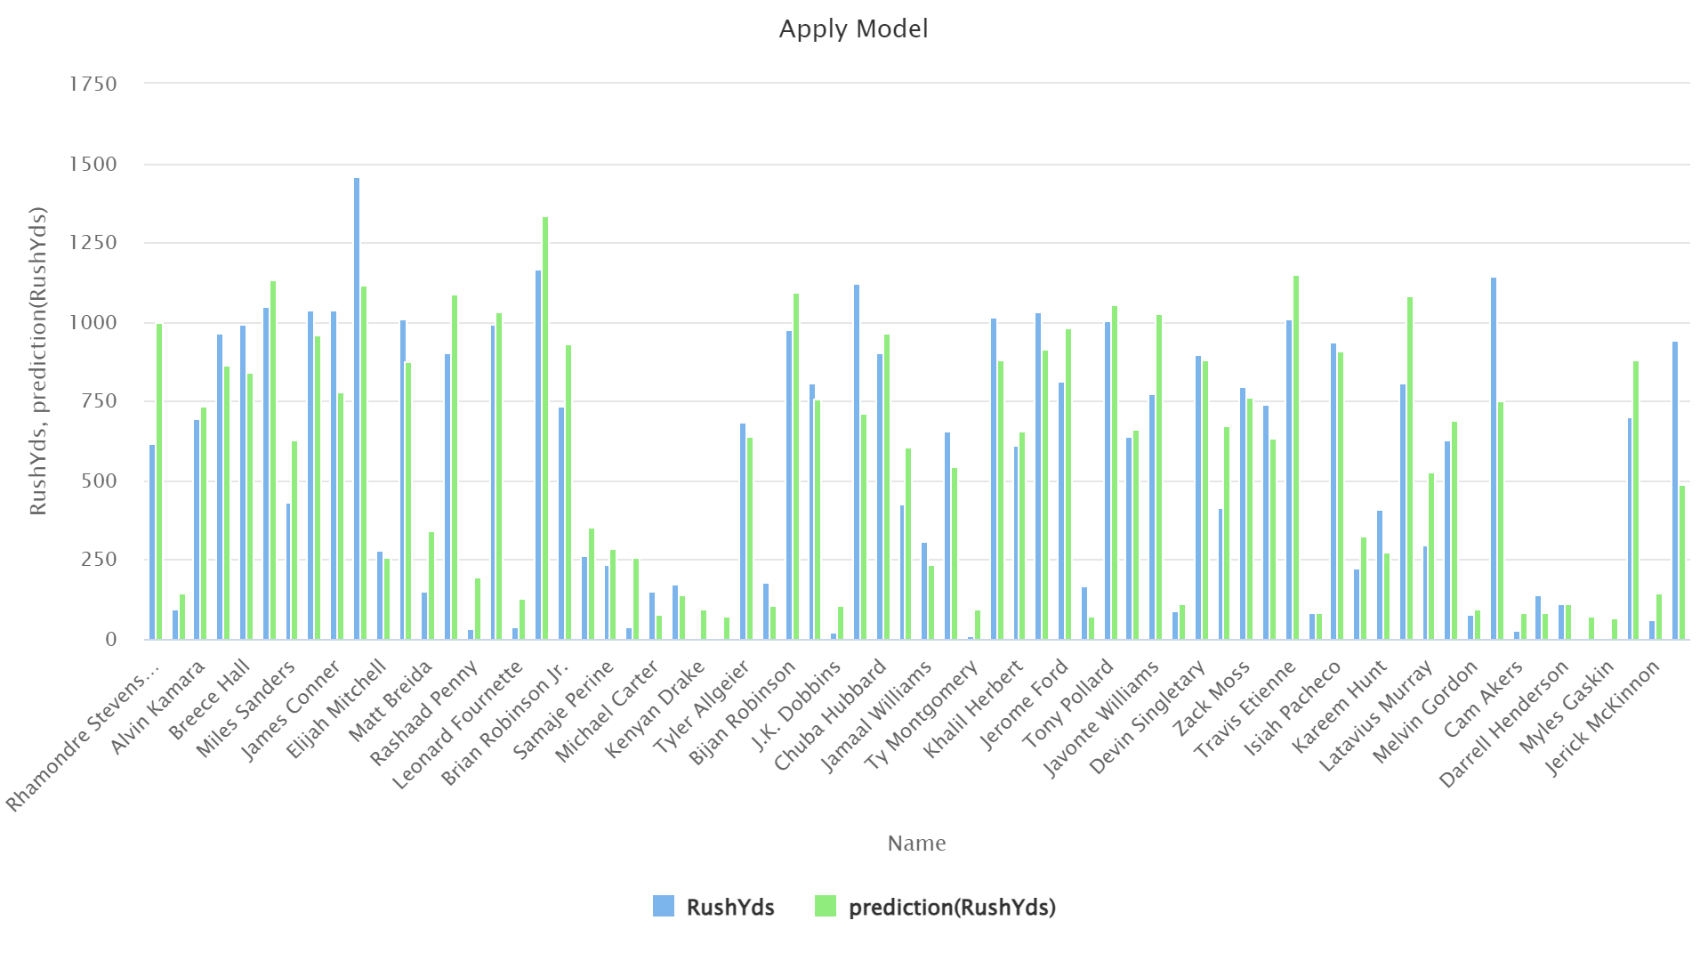
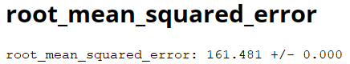
Results - Deep Learning
As you can see, the Deep Learner far out performed the Random Forest, reducing MSE by about 50.
We see that this model is significantly better at predicting low totals.
While it still isn’t perfectly accurate with stand-out seasons, it is a massive improvement.
Something to note, while it predicted that Derrick Henry would lead the league in rushing, the number that it gave wasn’t too far off of the actual league leader (1459 actual vs 1333 predicted
Notes:
This should be shown as a theoretical/”proof of concept” model, not our final result

Slide 24
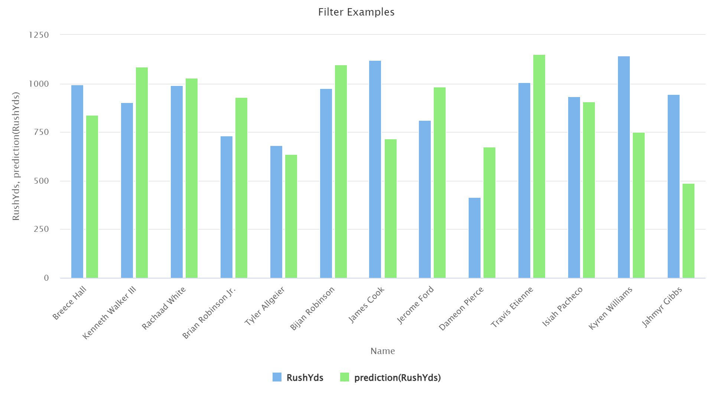
Results - Deep Learning
A key litmus test for our model’s performance was how it would handle players with little historical data, as this would give us insight into whether or not the model was learning anything about the team, coaches, and teammates and leveraging that data for its predictions.
This chart contains only the predictions for players with 2 or less years of service. It’s plain to see that the model is performing with good accuracy in most situations, and is most inaccurate when a player is particularly successful for a rookie.
For example, Jahmyr Gibbs was 4th in Offensive Rookie of the Year voting, so it’s understandable that he overshot his predicted yards.

Slide 25
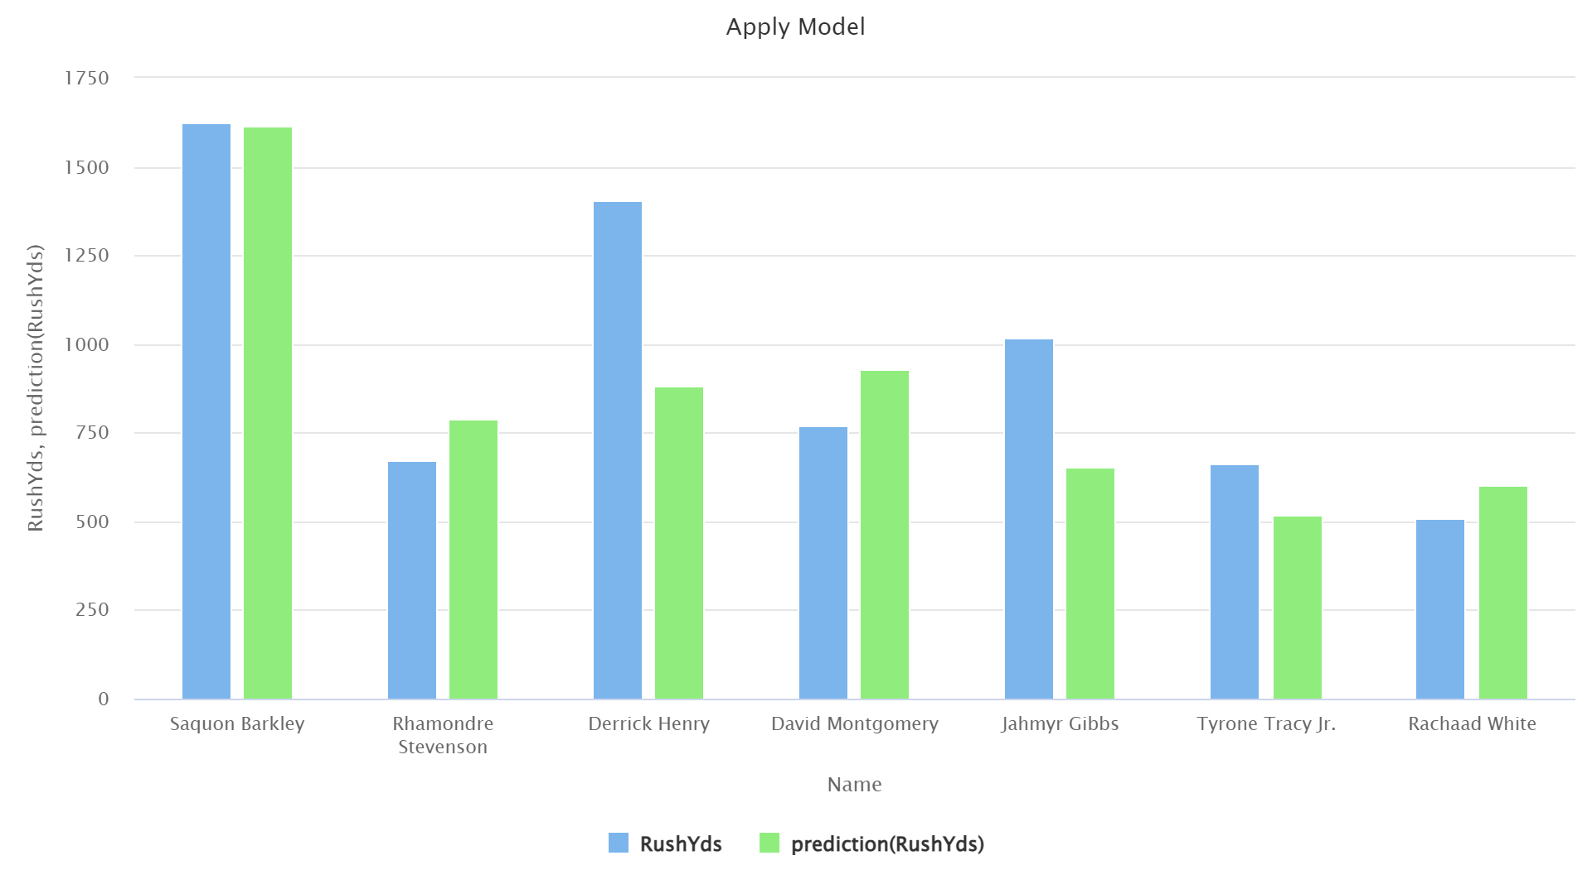
Results - Did We Overfit?
As we wrapped up our modelling, there were concerns voiced about whether or not our model was overfit to our training set.
After all, we did use 9 layers of 100 nodes. While Deep Learners are generally good at avoiding overfitting, it’s not impossible that we did end up with a biased model.
To test this, we grabbed new data from this year, appended our test set to the training data (since it would be valid historical data at this point) and ran the model against a few select players.
Saquon Barkley : New team this year, currently on pace to break the NFL rushing record.
Derrick Henry : New team this year that has recently had problems with their RB performance.
Jahmyr Gibbs and David Montgomery : Part of a 2-man rushing duo that are on the best offense in football.
Tyrone Tracy Jr. : A rookie for a team that has had poor offensive performance recently.
Rhamondre Stevenson : Same team, “control” entry
Rachaad White : Having a down year overall.
Based on those situations and the predictions the model made (especially Saquon), we believe that our model is not overfit to our training data at all.

Slide 26
6
DISCUSSION
“Let’s look at the film and see how we could improve”

Slide 27
Discussion and Recommendations
While we’re all very satisfied with the model’s performance there are certainly ways to improve it.
Better data quality : The TE position was not included due to a bug in the HTML scraper used to collect data. Additionally, more numerical data was not included that could have impact on the results. Physical attributes such as weight and height are likely to play a factor as well.
Stacking : Stacking is an advanced data science method in which several learning models are trained, and the outputs of those models are used as the inputs to a higher-level model. It’s possible that using the outputs of one of our models as inputs to the other (Random Forest into Deep Learning or vice versa), we could achieve even better results. However, due to time constraints and being novices in the area, we were unable to give this a fair shot.
With all of this done, did we answer the questions we had at the beginning of the process? Not all of them, because the problem is too complex to answer some of them simply (e.g., age does have an effect on performance, but it’s not the only factor). However, we do believe that this model is suited for generation of betting lines and forecasting performance overall, so it is in fact possible to predict performance based solely on what is known at the start of an NFL season.

Slide 28

Time for Questions
Thank you all for your attention and time!

